Slide 1
BROOKLYN COLLEGE AGAINST TRUMP PRESENTS
PRIVATIZATION:
And the Corporate Corruption of Everything
Jocelyn Wills
Brooklyn College, CUNY

Slide 2
Remember:
Trump is Just a Symptom,
Not the Cause, of the
Privatization Movement
KNOW THE HISTORY;
FOLLOW THE MONEY

Slide 3
The History of the Privatization
Movement, In Brief
The American State, its Founding in the Service of Capital/Capitalism, and the Corporation as a Juridical Construct, a way for the State to Socialize the Risk, and Privatize the Profit of Territorial Expansion and Imperialism, 1787-1930s…
Understanding the Constitution as an Economic Document: Property vs. Labor and Human Rights/Democracy

Slide 4
The History of the Privatization
Movement, In Brief
“Creative Destruction” and the Long Gilded Age—Capital over Labor, 1787-circa 1935
Financial Panics, Economic Recessions, and Great Depressions, some dates to remember: 1789, 1804, 1819, 1837-41, 1857-61, 1873-7, 1882-4, 1893-7, 1904-5, 1918-19, and 1929-41

Slide 5
The History of the Privatization
Movement, In Brief
The “Great Compression” & Saving Capitalism through Regulation, Collective Bargaining, and the Expansion of Civil Rights, circa 1935-1970
Some Highlights:
The Glass Steagall Act (1933) and the Regulation of Banking
The Social Security Act (1935) and the Social Safety Net
The Wagner Act (1935) and the American Labor Movement
The GI Bill (1944) and the Expansion of Higher Education
The Civil Rights Act (1964) and the “Great Society” Experiment
The Environmental Protection Act (1970) and Planet Earth

Slide 6
The History of the Privatization
Movement, In Brief
The New Gilded Age and Privatization Backlash: World War II as the Watershed Moment in the Rise of Surveillance Capitalism, Neoliberalism, the Military-Industrial-Academic-Prison Complex, and the Security-Police State. Selling off of the Public Sphere.
Economic Crises: Recessions of 1954-5 and 1957-61; OPEC, and Recession of 1972-5; Recession of 1981-4, Recession of 1991-4; Recession of 2000-03, the Mortgage Meltdown of 2007, and the Great Recession of 2008-)
Deregulation Highlights, 1970-2000: Airlines (1978); Partial Repeal of Glass-Steagall (1980); Natural Gas (1989); Electricity (1992); Telecommunications (1992); Financial Services (1999), aka the “Gramm-Leach-Bliley Act.

Slide 7
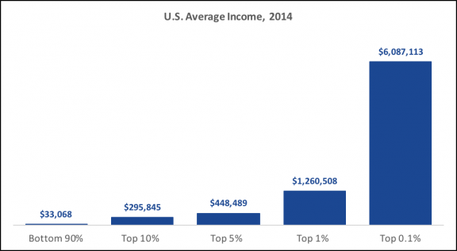
The History of the Privatization
Movement, In Brief:
Wealth and Income Inequality at 2014
(see: http://inequality.org/inequality-data-statistics/)

Slide 8
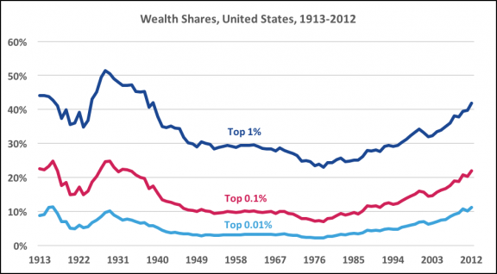
The History of the Privatization
Movement, In Brief:
Wealth and Income Inequality at 2014
(see: http://inequality.org/inequality-data-statistics/)

Slide 9
Here We Are:
Capitalism in the 21st Century, the Corporate Corruption of
Everything, and the Rise of Trumpism—
Follow the Money,Globally, and into the
Military-Industrial-Prison Complex

Slide 10
FOLLOW THE MONEY;
CONNECT THE DOTS;
LOOK FOR INTERSECTIONS;
REFLECT ON THIS LITTLE NEWS BLURB FOLLOWING
TRUMP’S SEIZURE OF POWER:
Fortune, November 9, 2016: "Of the 1000 largest U.S. companies, the biggest winner of the election was Corrections Corporation of America (CXW, +3.03%), one of the nation's largest operators of private prisons. Corrections Corp. stock soared more than 49% by the early afternoon, while another private-prison stock GEO Group (GEO, +3.27%) surged more than 21%."

Slide 11
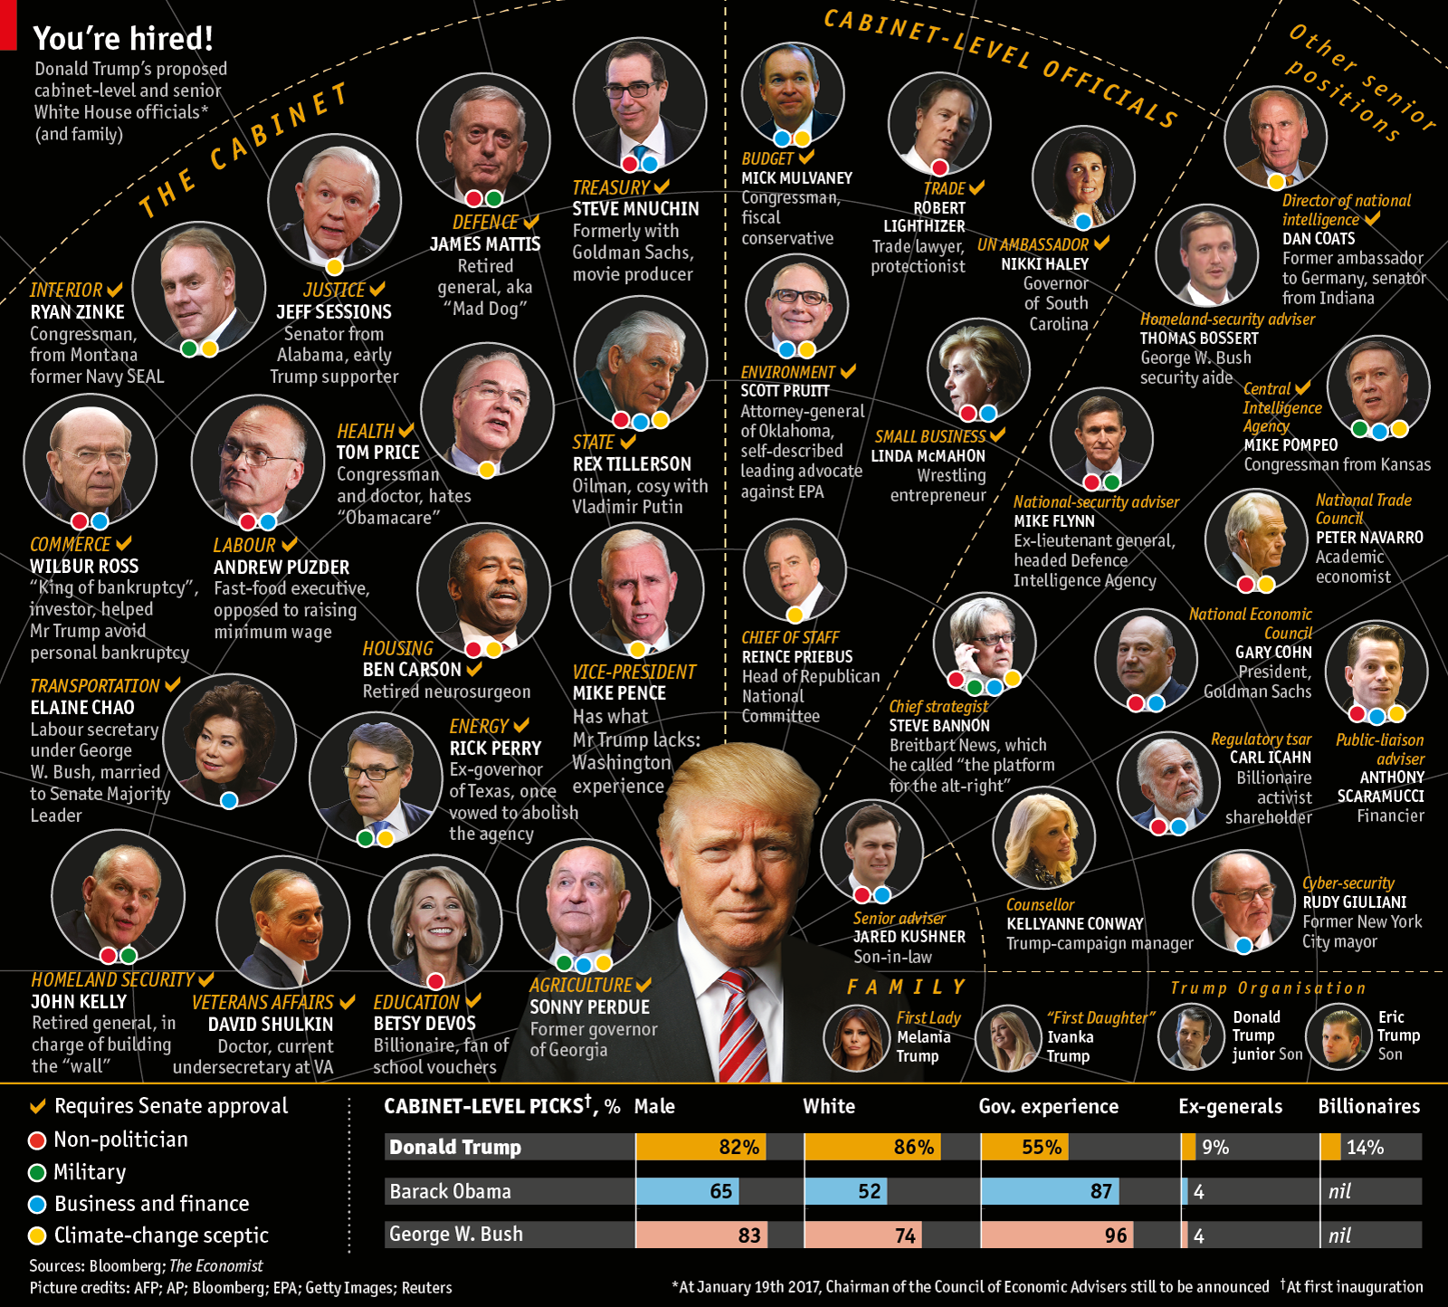

Slide 12
Trump’s Military-Industrial Cabinet
(confirmed and in waiting)
Source: The Economist, January 21, 2017
Male
White
Government Exp.
Ex-Generals
Billionaires
Non-politicians
Military connections
Business/Finance connect.
Climate Change “Skeptics”
Most connected in some way to “big” tech, pharma, oil, and government procurement contracting (esp. military)
Source: The Economist,
82% (Obama 65; Bush 83)
86% (Obama 52; Bush 74)
55% (Obama 87; Bush 94)
09% (Obama 4; Bush 4)
14% (Obama nil; Bush nil)
18 + 3 children = 21
At least 8
At least 19 + 3 children = 22
At least 16
As privatization advocates, most cozy with Bill Gates & the tech billionaires

Slide 13
Meet Trump’s Corporate Cabinet:
Vice President, Mike Pence
Lawyer, Conservative Radio/TV Talk Show Host, Christian Ideologue, member of Congress (House, 2000-13), and Tea Party Supporter—THE LINK TO CONGRESS.
As Governor of Indiana (2013-16), initiated largest tax cut in Indiana’s history, sponsored privatization of public education, state’s budget surplus through austerity measures aimed at the public safety net, and signed anti-abortion legislation/Religious Freedom Restoration Act, the latter a direct assault on the LGBTQ community. He also chaired Trump’s transition team and influenced many of Trump’s cabinet appointments.
He supports the privatization of everything and the dismantling of the Affordable Care Act. He is also a religious zealot & climate-change denier.
Net Worth and Business Interests: estimated worth, between $500K & $1M (miniscule compared to others), but works with billionaire backers of the GOP, including the Koch network.

Slide 14
Meet Trump’s Corporate Cabinet:
Secretary of State, Rex Tillerson
American oil executive and civil engineer, started at ExxonMobil in 1975.
Chairman and CEO, ExxonMobil, 2006-16.
Long-time contributor to the Republican Party (estimates, about $500K from 2000-16); industry lobbyist; close business ties to Vladimir Putin; and in 2014 opposed sanctions on Russia, “perhaps” due to his directorship on the joint US-Russian oil company, Exxon Neftlegas.
Advocate of fossil fuels, the Dakota Pipeline (among other oil and gas extraction projects); “partial” climate change denier; opponent of business and environmental regulations; supporter of heavy tax cuts for business; and champion of US military preparedness and engagement across the world.

Slide 15
Meet Trump’s Corporate Cabinet:
Secretary of the Treasury,
Steven Mnuchin
Alum of Goldman Sachs (1985-2002, in increasingly powerful positions; it might have helped that his father worked for Goldman since 1957); banker and movie producer.
Wide-ranging business interests and directorships, including in hedge funds, mortgage lenders (yes, ones that stimulated the housing boom and 2007 mortgage meltdown), and well-known for aggressive foreclosures.
Early supporter of Trump (and Paul Ryan), financially and otherwise.
Interested in cutting corporate taxes to 15%; advocates killing Dodd-Frank banking regulations.

Slide 16
Meet Trump’s Corporate Cabinet:
Secretary of Defense,
James Mattis
Served in the military from 1969-2013, rising through the ranks of the Marine Corps to General.
After retiring from the military in 2013, became a distinguished visiting fellow at the Hoover Institute, and served on the board of Theranos (a major Silicon Valley biotech firm).
Received a special waiver of the National Security Act of 1947, which requires a 7-year waiting period between military service and appointment as Secretary of Defense.
Has strong ties with military contractors, through his work at the Pentagon.

Slide 17
Meet Trump’s Corporate Cabinet:
Attorney General, Jeff Sessions
Washington Post & New York Times just broke the news (March 1st at 9:30 p.m.) that he also spoke with the Russian Ambassador during State Confirmation Hearing—he said he hadn’t, in his confirmation hearing.
Former senator from Alabama, known racist and segregationist, considered most conservative member of the senate, and is an investor in the very private prisons he has endorsed to criminalize people of color and the poor.
Immigration “hawk”—opponent of both legal and undocumented immigration; and early Trump supporter
A climate change denier; opponent of abortion and LGBTQ rights.
Consistently votes against funding for the VA medical system, education, the arts, and the environment; votes for military spending.
Opposed the stimulus bill following the financial crisis of 2008.
Receives 0% rating from the Human Rights Campaign

Slide 18
Meet Trump’s Corporate Cabinet:
Secretary of the Interior,
Ryan Zinke
Congressman from Montana and former Navy Seal.
Climate change denier; supports increased coal production and gas drilling.
Says he wants to manage rather than transfer public lands to private hands. We shall see. He’s a climate change “skeptic.”
Selectively advocates for deregulation.
Business career includes the founding of a property management and business development consulting company.

Slide 19
Meet Trump’s Corporate Cabinet:
Secretary of Commerce,
Wilbur Ross
Investor and considered the “King of Bankruptcy”—he helped Trump avoid personal bankruptcy; and has helped to reorganize failing companies, from steal and coal to telecommunications and textiles.
A major force in “casino capitalism”—represents investors in casinos, including Trump’s casinos.
Serves on the boards of the Brookings Institute, the Yale School of Management, and the Bank of Cyprus (famous as a place for the super rich to offshore their assets)
Advocate for deregulation.

Slide 20
Meet Trump’s Corporate Cabinet:
Secretary of Health & Human Services,
Tom Price
Former physician and Republican politician (in House of Representatives, from Georgia.
Number One Goal: to repeal the Affordable Care Act.
A climate change denier.
Opposes gun control
Advocate for deregulation.
Opposes the Environmental Protection Agency.
Voted to extend the Patriot Act; opposes spending everywhere but in the military and security state.

Slide 21
Meet Trump’s Corporate Cabinet:
Secretary of Transportation,
Elaine Chao
Married Mitch McConnell, the senior senator from Kentucky and current Senate Majority Leader, in 1993—enough said?
Her father was a shipping magnate, and she and her family emigrated from Taiwan to the United States; he father gave Chao and McConnell approximately $25 million in 2008 to increase their personal wealth.
In 2012, her family has donated $40 million to the Harvard Business School.
A distinguished fellow of the Heritage Foundation, she has also been a contributor to Fox News and other conservative media outlets.
2 major mining disasters took place while she was Secretary of Labor under George W. Bush; and investigations found that she had cut more than 100 coal mine safety inspections; it was also alleged that she and other White House officials campaigned for Republican candidates at taxpayer expense.
Resigned from the board of the Bloomberg Philanthropies over the Sierra Club’s plans for a “beyond coal” initiative.

Slide 22
Meet Trump’s Corporate Cabinet:
Secretary of Education,
Betsy DeVos
Billionaire heiress (the entitled daughter of a billionaire industrialist); religious ideologue; major donor of the Republican Party; married to the former CEO and multi-billion dollar heir to the Amway pyramid dynasty; advocate of charter schools and the privatization of public education; investor/owner in technology, manufacturing, “clean” energy, and dubious “therapy disorder” firms.
She and her husband have funded scholarships for “free enterprise” and “entrepreneurship.”
She is opposed to regulation of the economy and environment.
Has served as chairperson, board member, and treasurer of the Acton Institute for the Study of Religion and Liberty.
She has no experience in public education, and is an advocate for the privatization of higher education as well, all under the banner of “choice.”

Slide 23
Meet Trump’s Corporate Cabinet:
Secretary of Veteran’s Affairs,
David Shulkin
Served as President and CEO of Beth Israel Medical Center; and has served in various administrative positions at medical schools.
He was founder, chairman and CEO of “DoctorQuality, Inc.,” a “consumer-oriented” information service.
He began a career at Veterans Affairs in 2015, as the undersecretary for health.
He was unanimously confirmed by the senate.
Proposed eliminating the 40-mile, 30-day rule for non-VA care, so that veterans can exercise more choice in the private-sector heath care industry.

Slide 24
Meet Trump’s Corporate Cabinet:
Secretary of Homeland Security,
John F. Kelly
A retired Marine Corps general, and career military man who rose through the ranks, ultimately becoming the senior military assistant to the Secretary of Defense.
In 2014, he is quoted as saying, “"If you think this war against our way of life is over because some of the self-appointed opinion-makers and chattering class grow ‘war weary,’ because they want to be out of Iraq or Afghanistan, you are mistaken. This enemy is dedicated to our destruction. He will fight us for generations, and the conflict will move through various phases as it has since 9/11.“ He should be very good for military contractors, including those who specialize in various forms of surveillance.
Word is he cannot be bullied, because he’s the highest ranking officer to have lost a child fighting in Iraq and Afghanistan.
Now in charge of building the “wall.”

Slide 25
Meet Trump’s Corporate Cabinet:
Not Yet Confirmed, and
Your Homework Assignment
Do a deep search on and protest the confirmations of:
Secretary of Agriculture, Sonny Perdue
Secretary of Labor, Alexander Acosta
Secretary of Housing and Urban Development, Ben Carson
Secretary, Department of Energy, Rick “oops” Perry
Other Homework Assignment: research the history of Cabinet-Level Officials: Reince Priebus (Chief of Staff); Robert Lighthizer (US Trade Representative); Dan Coats (Director of National Intelligence); Nikki Haley (Ambassador to the UN); Mick Mulvaney (Office of Management and Budget); Mike Pompeo (Director, CIA); Scott Pruitt (Director, Environmental Protection Agency); and, of course, Steve Bannon (WH chief strategist)

Slide 26
WHAT IS TO BE DONE?
Stay Informed/Think Critically: start your day with Democracy Now! (Amy Goodman’s an excellent investigative reporter and often exposes corporate corruption well ahead of the curve; avoid getting sucked in my Trump’s drama and distraction tactics, and scour the New York Times and other major newspapers for stories linked to privatization of the public sphere.

Slide 27
What Is To Be Done?
Study the History of Capitalism, and other works challenging the American myth(s)
Recommended Readings (a starter kit):
Thomas Picketty, Capital in the 21st Century (read the compressed version if you find the “big” book too daunting); Michelle Alexander, The New Jim Crow; Ali Behdad, A Forgetful Nation; Ha-Joon Chang, Bad Samaritans; Jefferson Cowie, Stay’in Alive; Shamas Khan, Privilege; Chris Hedges, Empire of Illusion; Louis Hyman, Debtor Nation; Naomi Klein, This Changes Everything; Jennifer Washburn, University, Inc.; Craig Steven Wilder, A Covenant with Color; Howard Zinn; AND, instead of or along with 1984, Sinclair Lewis, It Can’t Happen Here.
Visit with me if you want to discuss other readings.

Slide 28
What Is To Be Done?
“For those of us who are white in particular, it is important to move beyond simple, happy narratives about immigration and gradual integration within a supposed melting pot society. We need to open and air our dirty history. If we don’t embrace and fully understand that dark history, then we will never be able to understand the present realities of others impacted by what is a shared history. That in turn will continue to keep us from moving towards reconciliation, reparations, transformation, and justice.”--Mike Merryman-Lotze, February 24, 2017, https://www.afsc.org.

Slide 29
What Is To Be Done?
RECLAIM THE PUBLIC from the private sector: demand public utilities—electricity and communications as just two examples; single-payer healthcare; free public education; publicly held and affordable transportation; affordable housing; regulations to maintain clean and safe water, clean and safe workplaces; publicly financed elections; etc.
VOTE, in EVERY ELECTION. We are all govened; the trick is by whom and for what ends. If you really want to change one of the two major parties, register with that party so you can vote in the primaries. You’re under no obligation to vote any party affiliation in the general.
ORGANIZE, in a current party, and get to work on a new one.
GET INVOLVED in the RESISTANCE to business as usual!

Slide 30
What Is To Be Done?
STOP SHOPPING for things you do not absolutely need. Barter, trade, and if you need to shop, do so locally, always avoiding chains and big box stores. If you must spend money, make donations to organizations resisting the structural forces of capitalism.
TAKE PUBLIC TRANSPORTATION and advocate for more affordable forms of it.
FIGHT FOR THE SOCIAL SAFETY NET, CHANGING THE AFFORDABLE CARE ACT to SINGLE PAYER, and FOR PEOPLE WITH DISABILITIES.
FIGHT FOR FULL STATE FUNDING FOR AND ACCESS TO PUBLIC EDUCATION—AND PROTEST TAX CUTS FOR THE RICH/TUITION HIKES FOR THE POOR. There’s money in the state/city; fight for the education, dignity, and respect you so richly deserve!

Slide 31
WHAT IS TO BE DONE!
PROTEST but PACE AND PROTECT YOURSELF…we need to be in this together, as a collective, and for the long, long haul; MAKE ALLIANCES.
JOIN or FORM a UNION/WORKER COOPERATIVE. Philanthropy is a ruse, one we won’t need if employers are forced to pay a living wage and provide healthy/safe environments. The only security issue we face is the inability to work and live with dignity.
EXPOSE and FIGHT AGAINST all forms of SURVEILLANCE in the service of BILLIONAIRES and the SECURITY-POLICE STATE.
TARGET, BOYCOTT, PROTEST, and OUST CORPORATIONS, INSTITUTIONAL APOLOGISTS, and ELECTED OFFICIALS PROFITING FROM THE MILITARY-INDUSTRIAL-ACADEMIC-PRISON COMPLEX AND THE UNENDING WAR ON THE POOR.

Slide 32
What Is To Be Done?
In Mississippi Burning, Gene Hackman’s character argued that “RATTLE SNAKES DON’T COMMIT SUICIDE.” They will never bite themselves; so we must do it.
WORK EVERY DAY, AND JOIN IN THE FIGHT TO END income and wealth inequality, austerity agendas, permanent war preparedness and the expansion of the police state, racism, misogyny, attacks on LGBTQ communities, Islamophobia and anti-Semitism, the criminalization of water protectors, immigrants, people of color, and the poor, settler-colonialism, and ongoing assaults on the planet and the world’s most vulnerable.
AND REMEMBER, all abuses of the environment and labor/civil/human rights are intimately linked to the creative destruction of capitalism and the neoliberal ideology of privatization and the corporate takeover/corruption of everything, including the very educational institution we inhabit. Capitalism and democratic strivings are fundamentally incompatible.

